Slide 1

HEALTH INSURANCE COST PREDICTION
UNDER THE GUIDANCE OF
Dr.B.Jhansi Vazram M.Tech.,Ph.D.
PROFESSOR
Submitted by:
B.Kalyani (19471A0570)
K.Lalitha Annapurna (19471A0591)
A.Bhavani (19471A0568)

Slide 2
CONTENTS
Abstract
System Requirements
Preprocessing Steps
Model Testings
Screenshots of project
Conclusion
Future Scope

Slide 3
Abstract
The health spending in the US is the highest among all developed nations in absolute numbers as well as a percentage of the economy.
We will develop a medical price prediction system using machine learning algorithms which will aid in steering patients to cost effective providers and thereby curb health spending.
The prediction of the medical price will be done using implementing Random Forest Regression algorithm in machine learning.
The policymakers can also use the tool to better understand which providers are relatively expensive and take punitive actions if necessary.
Additionally, we plan to include the experiments on the same data with other machine learning models such as Decision Trees and Linear Regression and compare results.

Slide 4
OBJECTIVE
The objective of Health insurance cost prediction system are :
To predict the health insurance of a pateint.
To showcase which patients get more health insurance.
To help the insurance agency to calculate the insurance of patients.

Slide 5
Requirements
Software Requirements
Hardware Requirements
Operating System : Window 10
Coding Language : Python
Python Distribution : Anaconda, Flask
Browser : Any Latest Browser Like Chrome
Processor : Intel Core i5
Cache Memory : 4MB
Hard Disk : 30GB or more
RAM : 1GB or more

Slide 6
DATA SET
We collected the data set from the Kaggle. Data Set consists of 7 variables. They are:
Age: age of primary beneficiary.
Sex: insurance contractor gender, female, male.
BMI: Body mass index, providing an understanding of body, weights that are relatively high or low relative to height, objective index of body weight (kg/m^2) using the ratio of height to weight, ideally 18.5 to 24.9.
Children: Number of children covered by health insurance/Number of dependents.
Smoker: Is the person a smoker or not.
Region: the beneficiary’s residential area in the US, northeast, southeast, southwest, northwest.
Charges: Individual medical costs billed by health insurance.

Slide 7
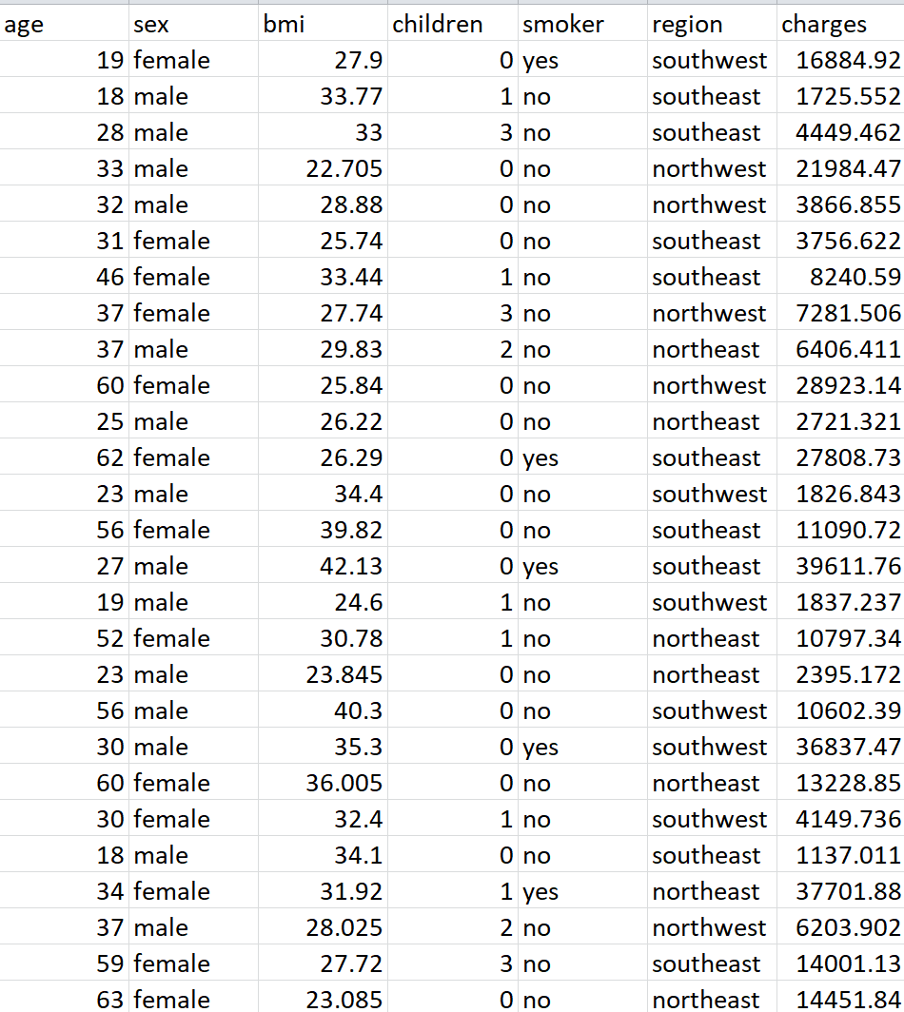
Sample of Dataset

Slide 8
Pre-processing
Before feeding data to an algorithm we have to apply transformations to our data which is referred as pre-processing.
Sex | Male / Female 0=Male 1=Female
Smoker | Whether or not a client smokes 1=yes 0=no
Region | Whether the client lives in southwest, northwest, southeast or northeast 1=southeast 2=southwest 3=northeast 4=northwest

Slide 9

Linear Regression
Linear Regression is the first machine learning algorithm based on ‘Supervised Learning’.
Linear regression performs the task to predict a dependent variable value (y) based on a given independent variable (x).
It is a statistical method that is used for predictive analysis.

Slide 10
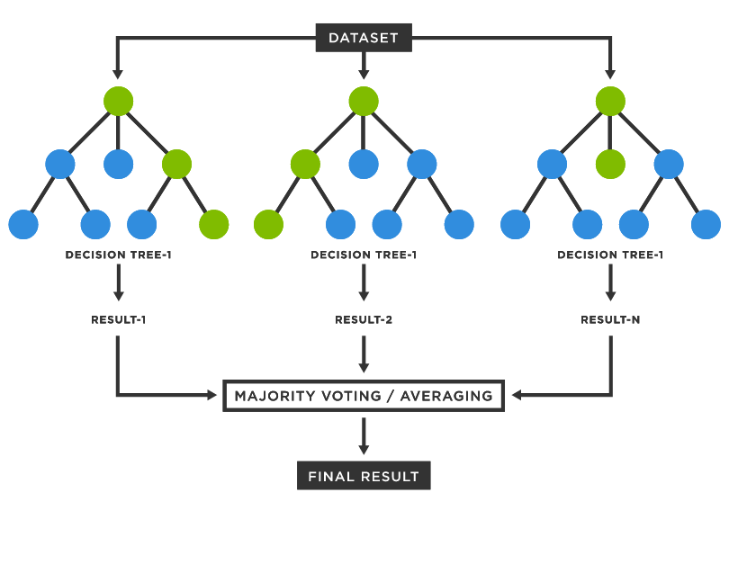
Random Forest Regression
Random Forest is an ensemble technique capable of performing both regression and classification tasks with the use of multiple decision trees and a technique called Bootstrap and Aggregation, commonly known as bagging.
Random Forest runs efficiently on large datasets.
Random Forest has a high accuracy than other algorithms.

Slide 11
Decision Tree Regression
Decision Tree Analysis is a general, predictive modelling tool that has applications spanning a number of different areas.
It is one of the most widely used and practical methods for supervised learning.
Decision Trees are a non-parametric supervised learning method used for both classification and regression tasks.
The decision rules are generally in form of if-then-else statements.
The deeper the tree, the more complex the rules and fitter the model.

Slide 12
Comparing Models
Linear Regression
Random Forest Regression
Decision tree regression
Accuracy of Linear Regression on insurance dataset is 76%
Accuracy of Random Forest Regression on insurance dataset is 85%
Accuracy of Decision tree regression on insurance dataset is 71%
Therefore we used Random Forest Regression model on the insurance dataset.

Slide 13
Output
Any patient insurance can be predicted with the valid information.
And the accuracy of the predicted insurance is 85%
Helps the insurance agency to calculate the insurance of a patient.

Slide 14
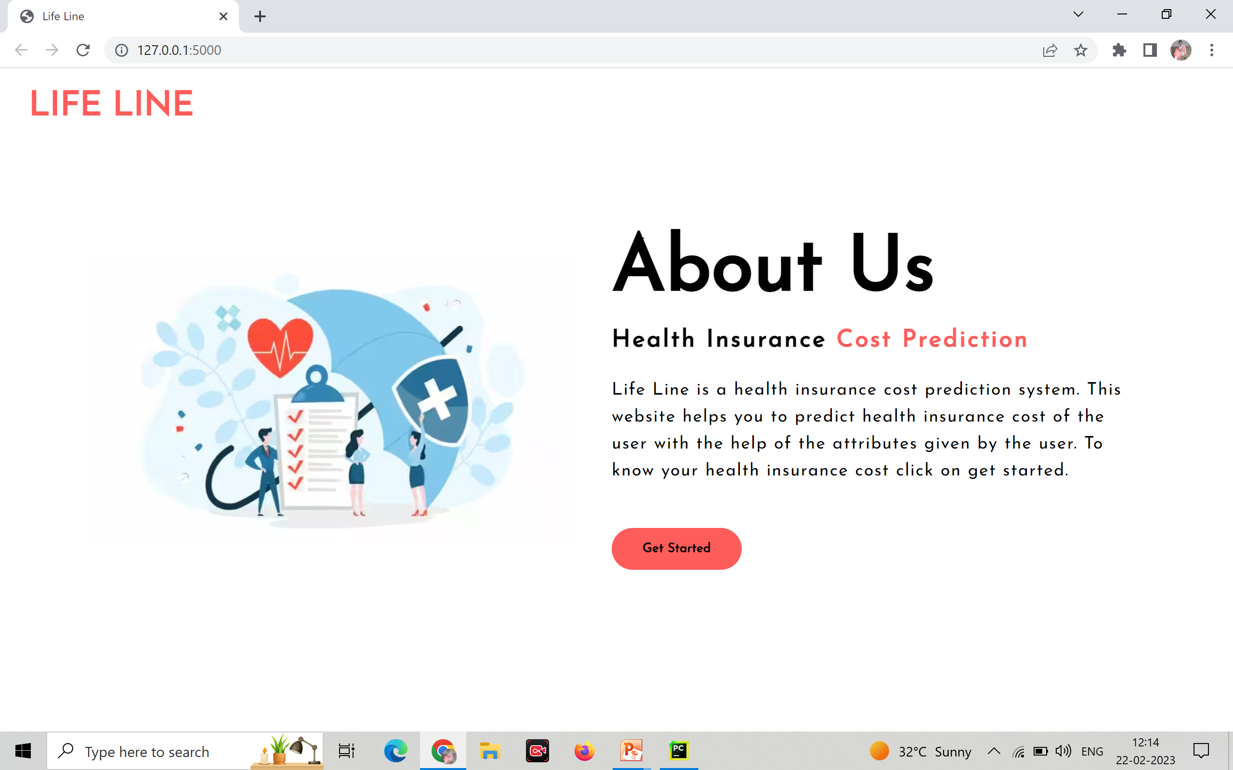
Screenshots of Project

Slide 15
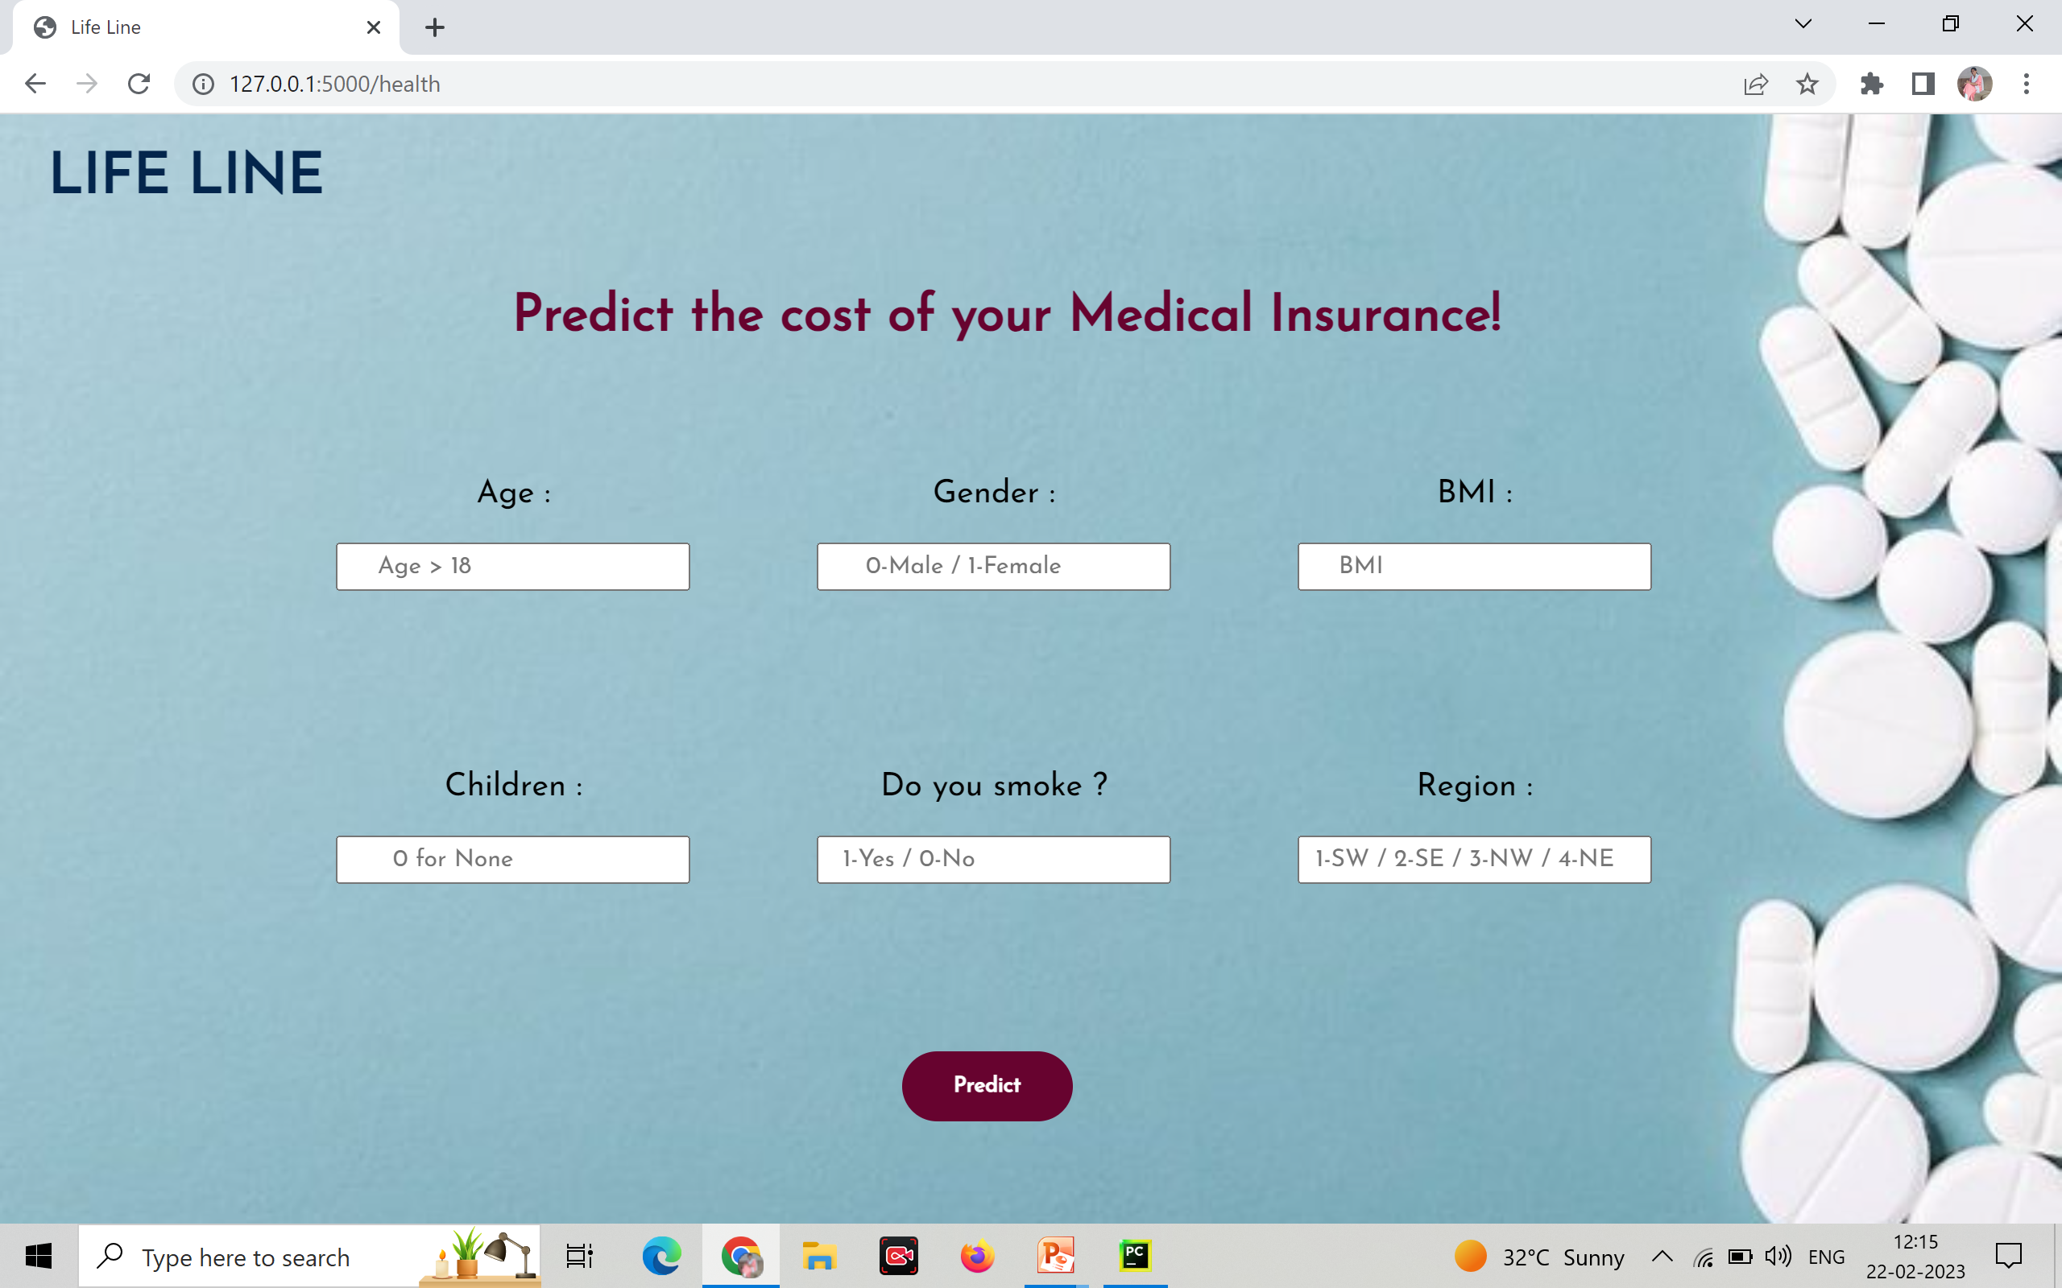

Slide 16
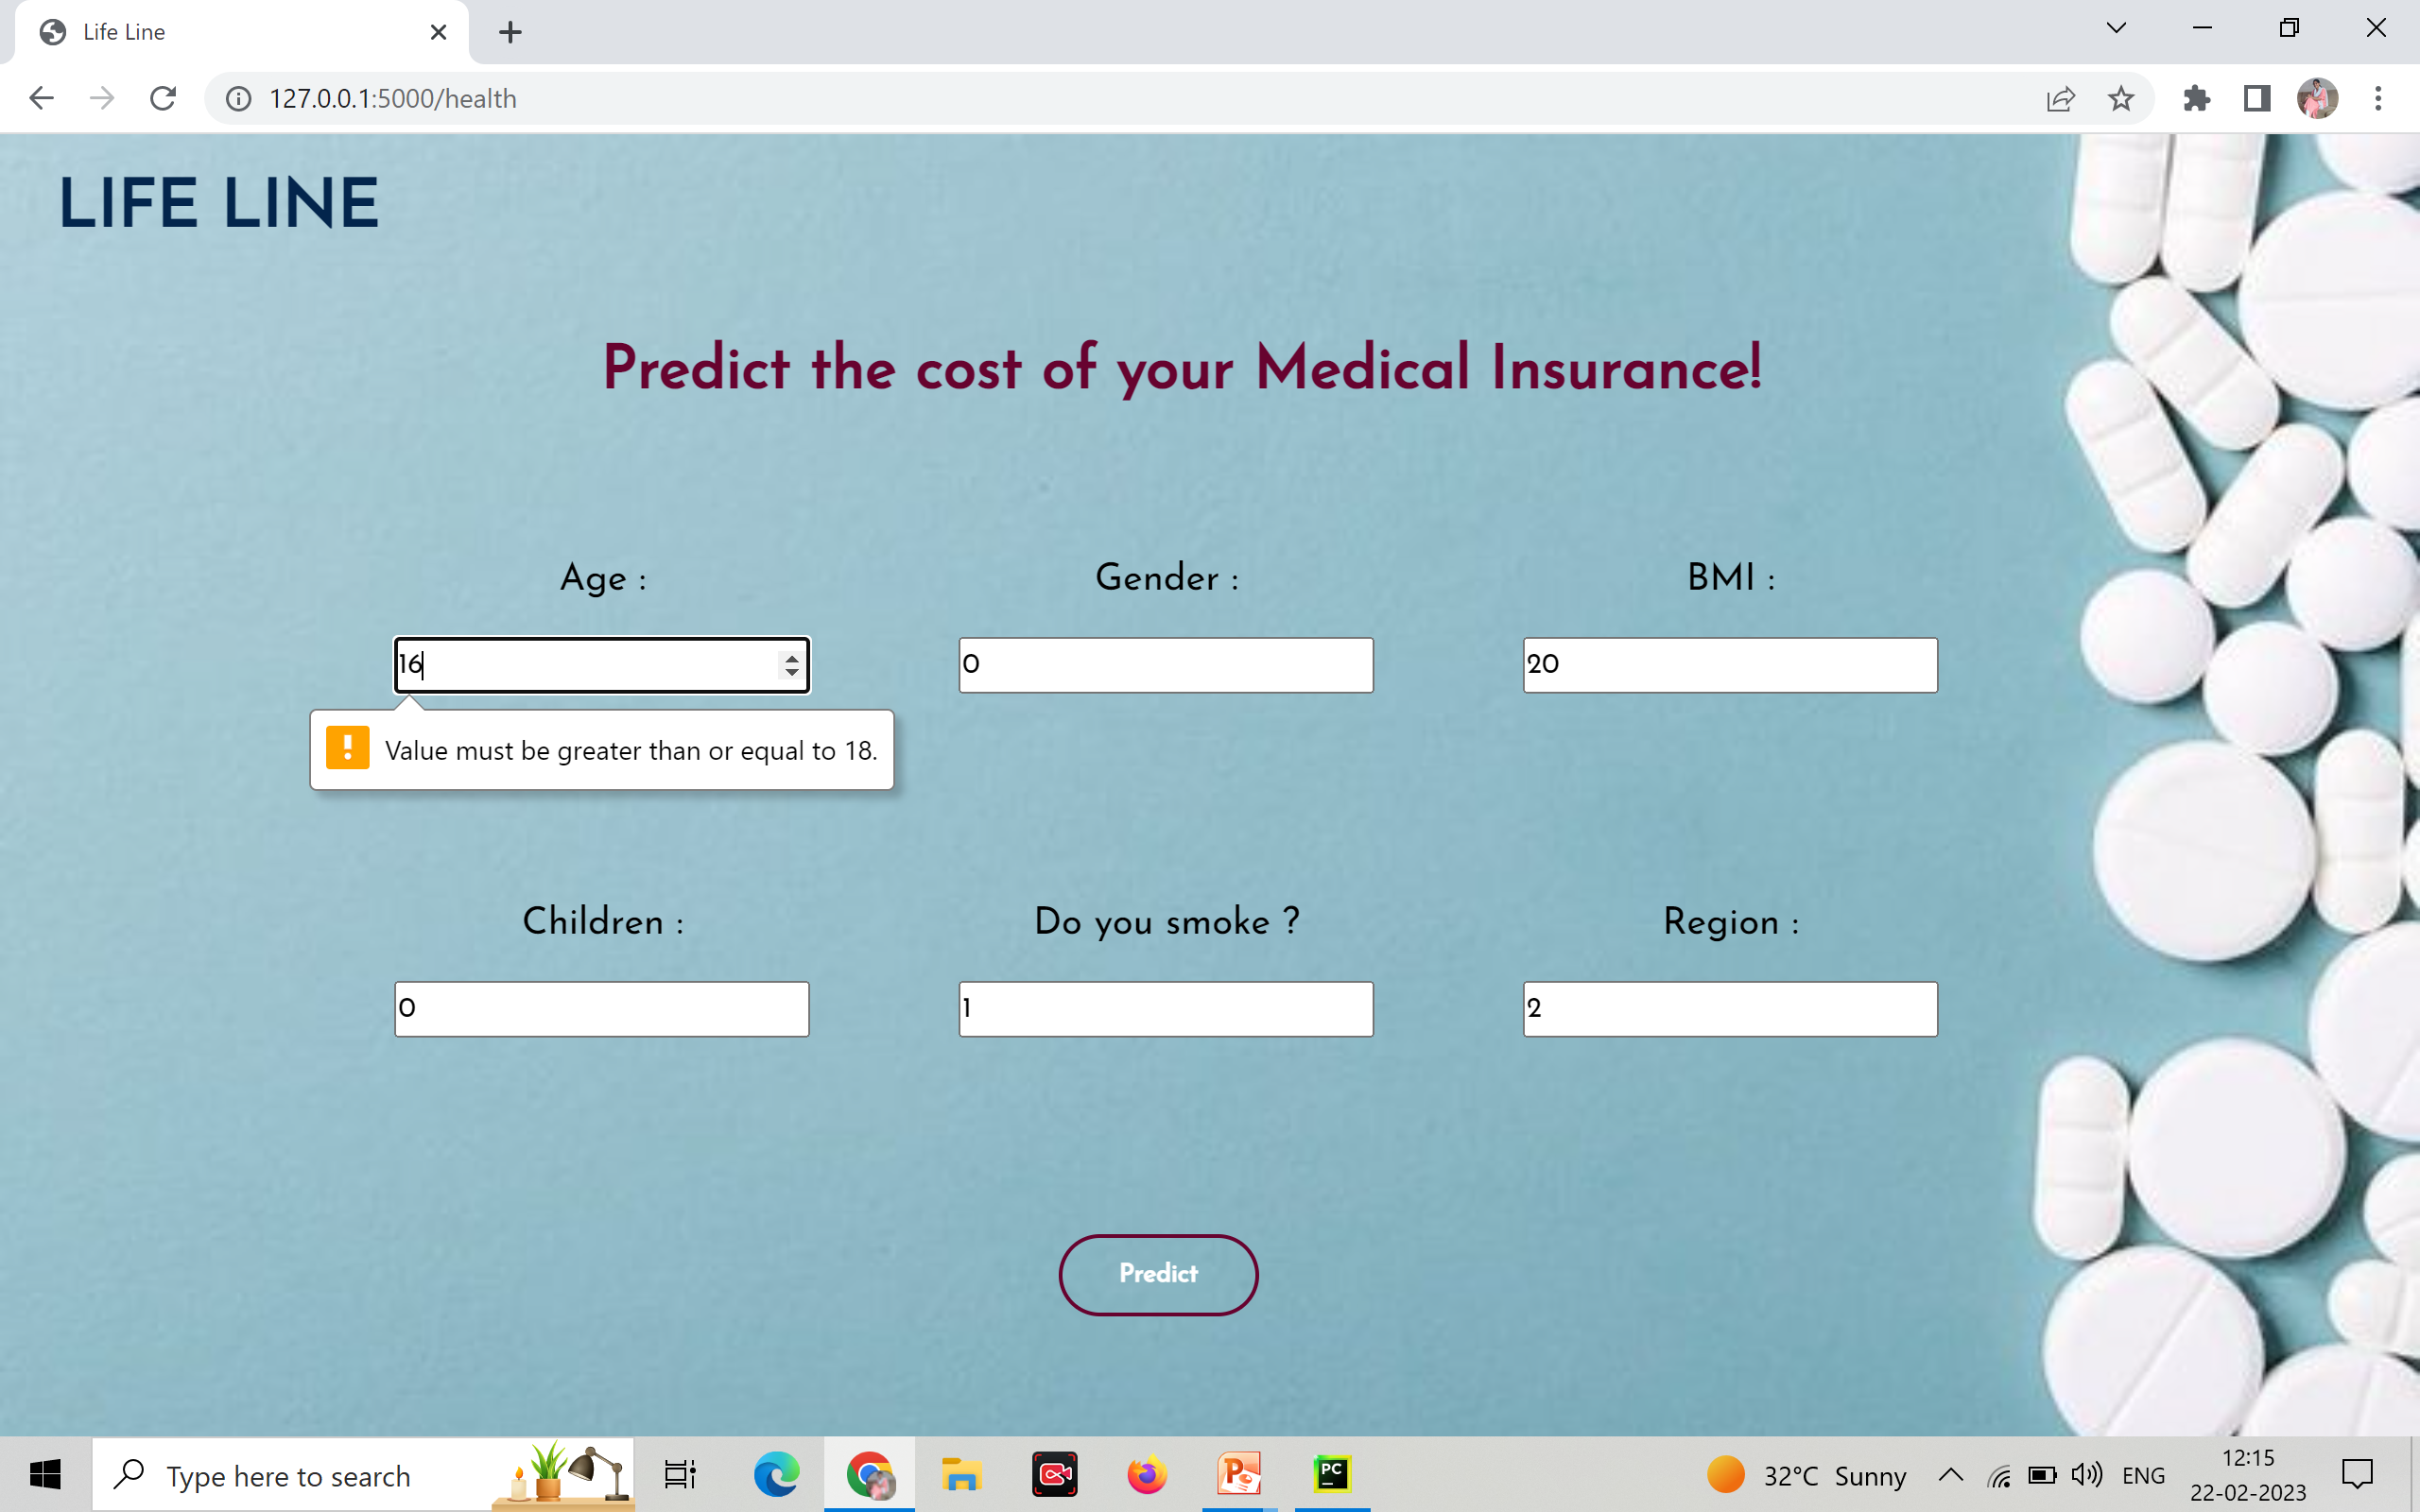

Slide 17
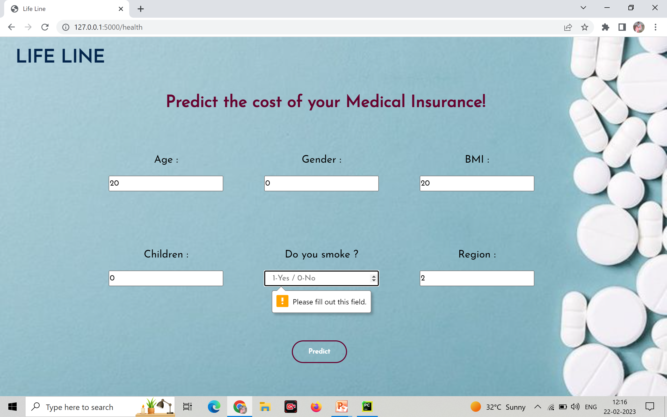

Slide 18


Slide 19
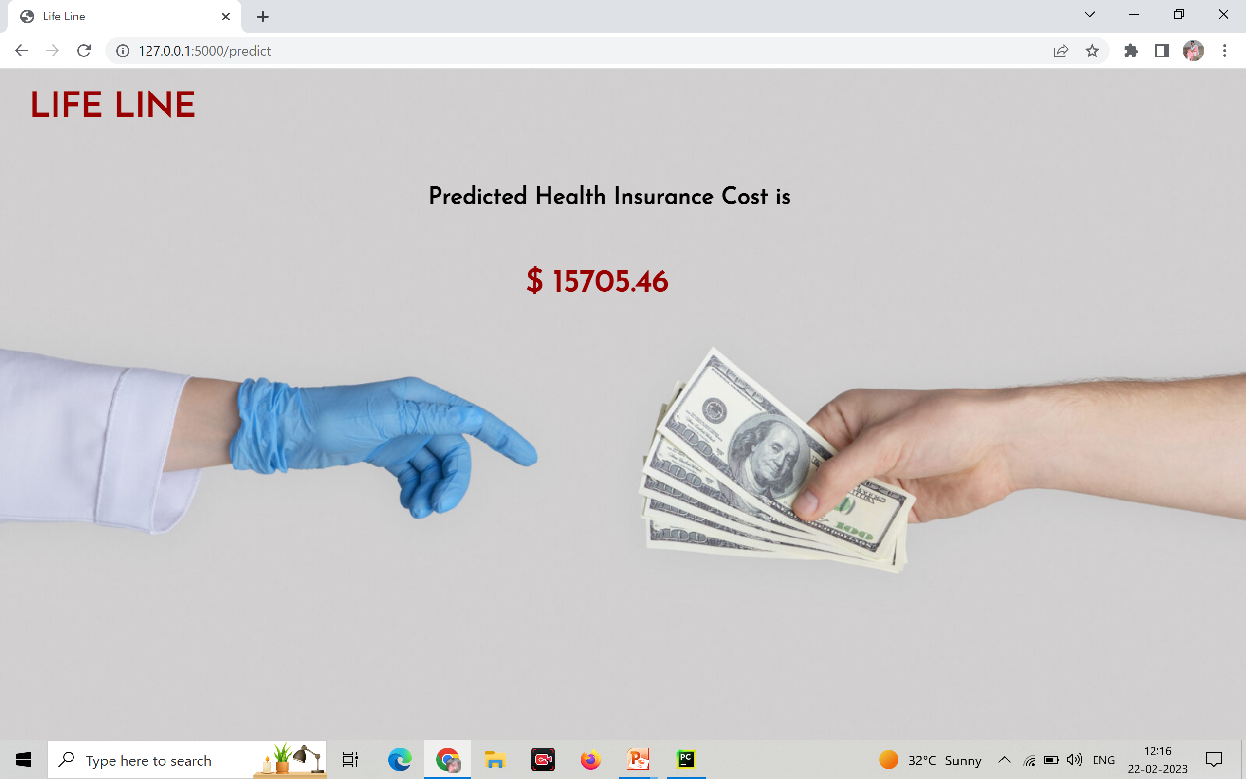

Slide 20
Future Scope
To develop more accuracy using machine learning algorithms & advanced techniques.
To improve the health insurance prediction system.
Conclusion
We are able to predict the insurance of patients. And help the insurance agencies to calculate the insurance of their clients.

Slide 21
THANK YOU

Slide 22
Testimonials
Claire Blair
John Stone
Mike Mills
“Mercury is the smallest planet”
“Despite being red, Mars is a cold place”
“Jupiter is the biggest planet”
Bob Charlton
Kate Poe
Lilly Roberts
“Saturn is a gas giant and has rings”
“Neptune is far away from Earth”
“Venus is the second planet from the Sun”

